Slide 1
Activities and Activity Lifecycle
CTAPDEVL
Prepared by:
Elizer Ponio Jr.

Slide 2
Contents
Introduction to Activities
The Activity Lifecycle

Slide 3
Introduction to Activities

Slide 4
Introduction to Activities
Unlike most programming languages, in which the main()method is the entry point for that program or application to start its execution, the android operating system initiates the code in an Activity instance

Slide 5
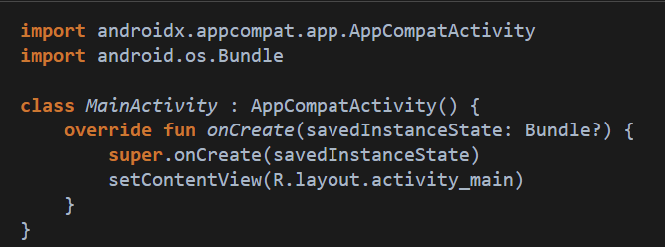

Introduction to Activities
MainActivity.kt

Slide 6
What is an Activity?
An activity is the entry point for interacting with the user.
Every activity contains the layout, which has a user interface to interact with the user.

Slide 7
What is an Activity?
An activity provides the window in which the app draws its UI.
Generally, one activity implements one screen in an app.

Slide 8
What is an Activity?
Typically, one activity in an app is specified as the main activity, which is the first screen to appear when the user launches the app.

Slide 9
What is an Activity?
Each activity can then start another activity in order to perform different actions.

Slide 10
What is an Activity?
The layout for a particular activity is set with the help of setContentView()

Slide 11
What is an Activity?
setContentView() is a function that takes View as a parameter. The view parameter basically contains the layout file for that activity.

Slide 12
The Activity Lifecycle

Slide 13
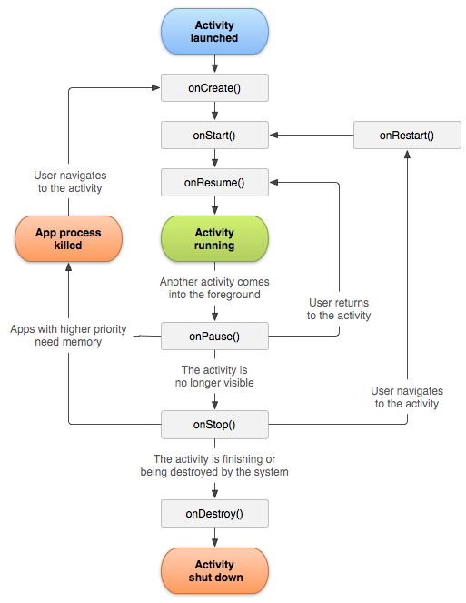
Activity Lifecycle
As the user navigates through, out of, and back to your app, the Activity instances in your app transition through different states in their lifecycle.

Slide 14
Activity Lifecycle
The Activity class provides a number of callbacks that let the activity know when a state changes or that the system is creating, stopping, or resuming an activity or destroying the process the activity resides in.

Slide 15
Activity Lifecycle
To navigate transitions between stages of the activity lifecycle, the Activity class provides a core set of six callbacks

Slide 16
Lifecycle Callbacks
onCreate()
onStart()
onResume()
onPause()
onStop()
onDestroy()

Slide 17
Lifecycle Callbacks
The system invokes each of these callbacks as the activity enters a new state.

Slide 19
onCreate()
The onCreate() method is the place, where the user initializes the activity.
This method is called when the activity is starting and also the method that is used to initialize most of the things in the android app.

Slide 20
onCreate()
You must implement this callback, which executes when the system first creates the activity.
On activity creation, the activity enters the Created state. This is where you should perform basic application startup logic that happens only once for the entire life of the activity.

Slide 21
onCreate()
The onCreate() method takes savedInstanceState as the parameter, which the object of type Bundle.

Slide 22
onCreate()
Bundle Object which contains the previously saved data of the activity. If the activity is newly created then the bundle won’t be saving any data of the activity and would contain the null value.

Slide 23
onCreate()
The onCreate() method calls the setContentView() method to set the view corresponding to the activity.

Slide 24
onStart()
When the activity enters the Started state, the system invokes onStart().
This call makes the activity visible to the user as the app prepares for the activity to enter the foreground and become interactive.
For example, this method is where the code that maintains the UI is initialized.

Slide 25
onStart()
The onStart() method completes quickly and, as with the Created state, the activity does not remain in the Started state.
Once this callback finishes, the activity enters the Resumed state and the system invokes the onResume() method.

Slide 26
onResume()
When the activity enters the Resumed state, it comes to the foreground, and the system invokes the onResume() callback.
This is the state in which the app interacts with the user.

Slide 27
onResume()
The app stays in this state until something happens to take focus away from the app, such as the device receiving a phone call, the user navigating to another activity, or the device screen turning off.

Slide 28
onResume()
When an interruptive event occurs, the activity enters the Paused state and the system invokes the onPause() callback.

Slide 29
onResume()
If the activity returns to the Resumed state from the Paused state, the system once again calls the onResume() method

Slide 30
onPause()
The system calls this method as the first indication that the user is leaving an activity, though it does not always mean the activity is being destroyed.

Slide 31
onPause()
It indicates that the activity is no longer in the foreground, but it is still visible if the user is in multi-window mode.

Slide 32
onPause()
There are several reasons why an activity might enter this state:

Slide 33
onPause()
There are several reasons why an activity might enter this state:
An event that interrupts app execution, as described in the section about the onResume() callback, pauses the current activity. This is the most common case.
In multi-window mode, only one app has focus at any time, and the system pauses all the other apps.
The opening of a new, semi-transparent activity, such as a dialog, pauses the activity it covers. As long as the activity is partially visible but not in focus, it remains paused.

Slide 34
onPause()
Completion of the onPause() method does not mean that the activity leaves the Paused state.
Rather, the activity remains in this state until either the activity resumes or it becomes completely invisible to the user. If the activity resumes, the system once again invokes the onResume() callback.

Slide 35
onPause()
Completion of the onPause() method does not mean that the activity leaves the Paused state.
Rather, the activity remains in this state until either the activity resumes or it becomes completely invisible to the user. If the activity resumes, the system once again invokes the onResume() callback.

Slide 36
onPause()
If the activity becomes completely invisible, the system calls onStop().

Slide 37
onStop()
When your activity is no longer visible to the user, it enters the Stopped state, and the system invokes the onStop() callback.
The system also calls onStop() when the activity finishes running and is about to be terminated.

Slide 38
onStop()
In the onStop() method, release or adjust resources that are not needed while the app is not visible to the user.

Slide 39
onDestroy()
onDestroy() is called before the activity is destroyed. The system invokes this callback for one of two reasons:
The activity is finishing, due to the user completely dismissing the activity or due to finish() being called on the activity.
The system is temporarily destroying the activity due to a configuration change, such as device rotation or entering multi-window mode.

Slide 40
References
https://developer.android.com/guide/components/activities/activity-lifecycle#ondestroy
https://www.geeksforgeeks.org/introduction-to-activities-in-android/

Slide 41
END

